Slide 1


t e a m 11
Raising awareness for dementia

Slide 2
Plan
Problem Statement
Key Requirements
Benefit users
Benefit organisation
Meet specification
Ideas
Explanation of implementation
Demo (if any)
Future developments
Bibliography

Slide 3
Challenge Statement
Create a web application that allows user to empathise with dementia sufferers. This could be aided with the use of social media.
Notes:
Mobile or Web Application that demonstrates what it might be like to have dementia through the use of a social media account. The application should help users understand and appreciate the effects of dementia on those that are affected as well as theirs friends and love ones, encouraging people to share the application and donate to the charity.

Slide 4
Requirements:
The application should:
- increase awareness of dementia
- help remove the false connotations associated with dementia
- help expand pre existing knowledge of the disease
- be able to facilitate sharing capabilities within social media
Notes:
Mobile or Web Application that demonstrates what it might be like to have dementia through the use of a social media account. The application should help users understand and appreciate the effects of dementia on those that are affected as well as theirs friends and love ones, encouraging people to share the application and donate to the charity.

Slide 5
Ideas:
A retro based text game that simulated a character quickly developing the symptoms of dementia.
A variety of mini games, each based on a particular symptom of dementia.
Notes:
We felt the text based game would be less engaging as it text based games are not a novelty.
This second idea was partially implemented with the final idea.

Slide 6
Final idea:
A question based web application that:
questions user’s pre-existing assumptions of dementia
includes information to raise awareness of the disease
allows a user to share their score and see their friend’s scores

Slide 7
Explanation of Implementation
Front end written in:
Javascript
HTML
CSS
JavaScript is also used to simulate the penalties for incorrect answers.
Notes:
Front end written in Javascript which provides the logic of the application by transitioning between questions and returning the results.
HTML and CSS being used to render the web pages. The user is also returned a message when they answer a question incorrectly to explain the correct answer.
JavaScript is also used to simulate the penalties for incorrect answers and with each incorrect answer, the following question will be modified in a way that it will be simulated to show how a person with Alzheimer's would approach the problem with modifications such as missing or confusing words in simple sentences, trouble with organisation and simple numeracy questions and general memory loss.

Slide 8
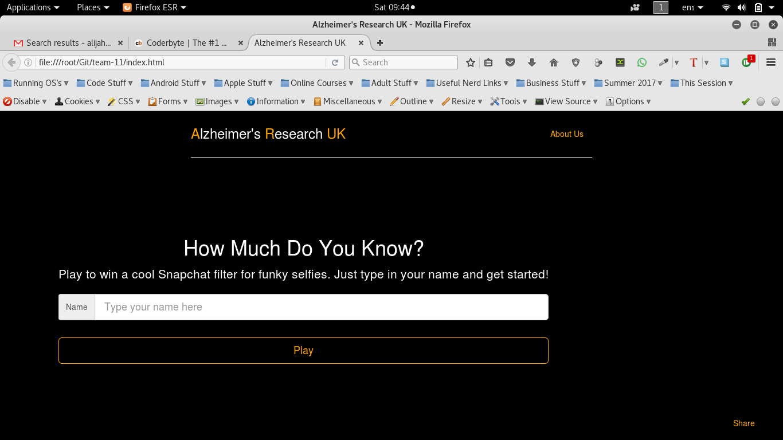
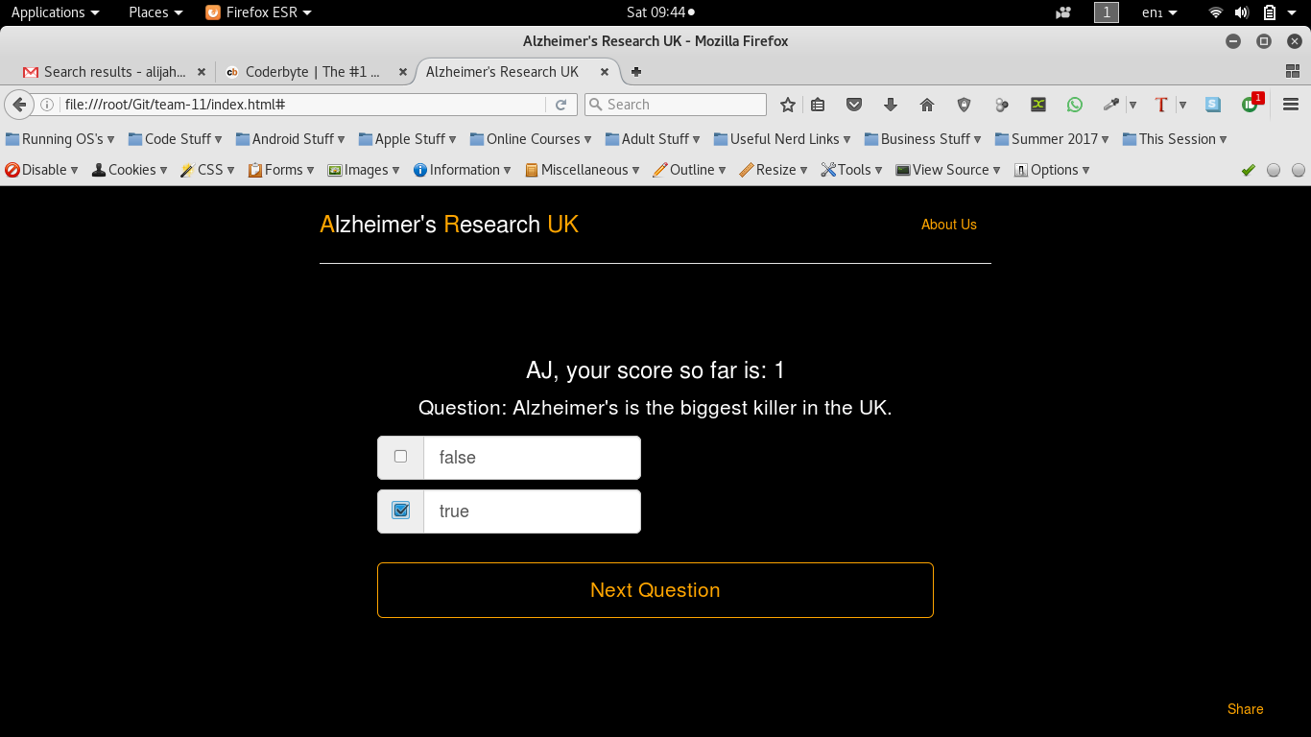
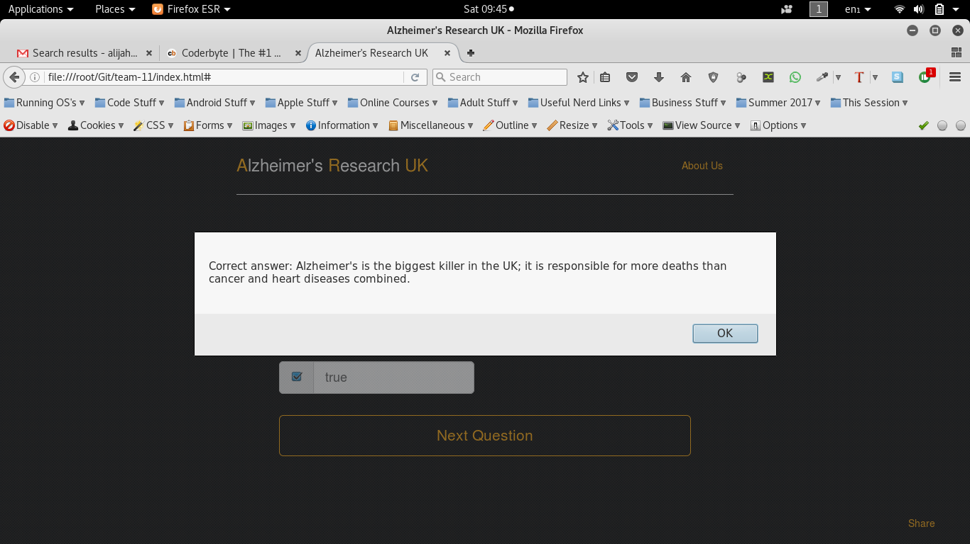
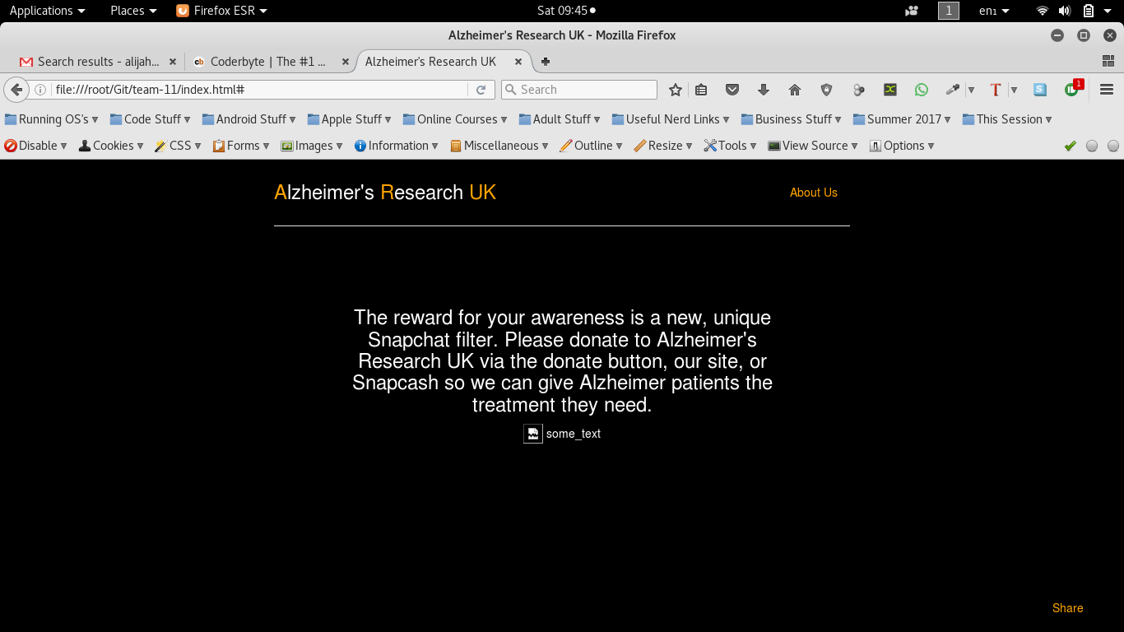

Screenshots
Notes:
Landing page asks them for a question and immediately engages them
They are them asked a series of questions where they must answer from multiple choice, these will be expanded to different questions by expanding the question database.
They are also shown facts to increase knowledge and combat misconceptions.
They are then shown the reward page upon completion where they can download the Snapchat filter, donate money and share the app to friends via social media

Slide 9
Future Development
An animation of an orange being peeled (when questions are incorrectly answered).
Implementing a back end database.
Exclusive Alzheimer’s Research UK snapchat filter and Snapchat Snapcash feature.
Greater social media integration and possible iOS and Android apps.
Add an incentive; unlock a snapchat filter if you score higher than a certain score.
Snapchat filter something that would be shared and will raise awareness.
Notes:
Instead of having a generic health
to store many more questions that can be queried by a web server for questions to make the selection random each time.
As a incentive to share the application with friends, the sharer will be rewarded with it. As previously created snapchat filters have proven successful. Allowing follower to send cash through a linked debit card.
Currently allows you to share your score and the site link to your feed but more integration can allow the user to allow share their profile with the site, allowing us to tailor questions based on their profile.

Slide 10
References:
“What is the most common form of dementia?” Judd, N. and Society, A. (2007) What is Alzheimer’s disease? - Alzheimer’s society. Available at: https://www.alzheimers.org.uk/site/scripts/documents_info.php?documentID=100 (Accessed: 10 December 2016).
“Who has a higher risk of developing Alzheimer’s disease?” Sauer, A. (2015) Why is Alzheimer’s more likely in women? Available at: http://www.alzheimers.net/8-12-15-why-is-alzheimers-more-likely-in-women/ (Accessed: 10 December 2016).
“What are the two proteins responsible for dementia?” Bloom, G.S. (2014) ‘Amyloid-β and Tau’, JAMA Neurology, 71(4), p. 505. doi: 10.1001/jamaneurol.2013.5847.
“Is there a cure for Alzheimer’s disease?” Association®, A. (2016) Latest treatment options. Available at: http://www.alz.org/alzheimers_disease_treatments.asp (Accessed: 10 December 2016).
“How much does dementia effect the global economy?” 10 things you need to know about the impact of dementia on people, carers and the economy | Alzheimer’s research UK (2017) Available at: http://www.alzheimersresearchuk.org/about-dementia/facts-stats/10-things-you-need-to-know-about-the-impact-of-dementia/ (Accessed: 10 December 2016).
“Is Alzheimer’s disease fatal?” Association®, A. (2016) Memory loss myths & facts. Available at: http://www.alz.org/alzheimers_disease_myths_about_alzheimers.asp (Accessed: 10 December 2016).
Does Alzheimer's only effect people over 65? Association®, A. (2016) Memory loss myths & facts. Available at: http://www.alz.org/alzheimers_disease_myths_about_alzheimers.asp (Accessed: 10 December 2016).
“Alzheimer’s and Dimentia are the leading causes of death in the UK?” Siddique, H. (2016) Dementia and Alzheimer’s leading cause of death in England and wales. Available at: https://www.theguardian.com/society/2016/nov/14/dementia-and-alzheimers-leading-cause-of-death-england-and-wales (Accessed: 10 December 2016).
“Are the most prominent symptoms of Alzheimer's disease include memory loss, gradual loss of speech, and/or difficulties with any physical movements?” Choices, N. (2016) Alzheimer’s disease - symptoms. Available at: http://www.nhs.uk/Conditions/Alzheimers-disease/Pages/Symptoms.aspx (Accessed: 10 December 2016).
Notes:
“What is the most common form of dementia?”
“Who has a higher risk of developing Alzheimer’s disease?”
“What are the two proteins responsible for dementia?”
“Is there a cure for Alzheimer’s disease?”
“How much does dementia effect the global economy?”
~ “Is Alzheimer’s disease fatal?”
Does Alzheimer's only effect people over 65? (question in app different wording but same context)
“Alzheimer’s and Dimentia are the leading causes of death in the UK?”
“Are the most prominent symptoms of Alzheimer's disease include memory loss, gradual loss of speech, and/or difficulties with any physical movements?”

Slide 11

t h a n k y o u

